Slide 1
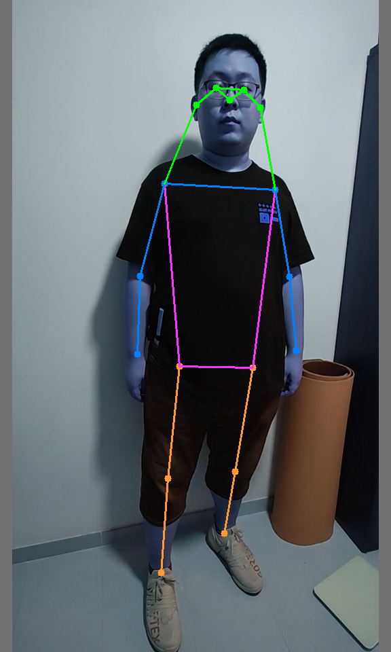
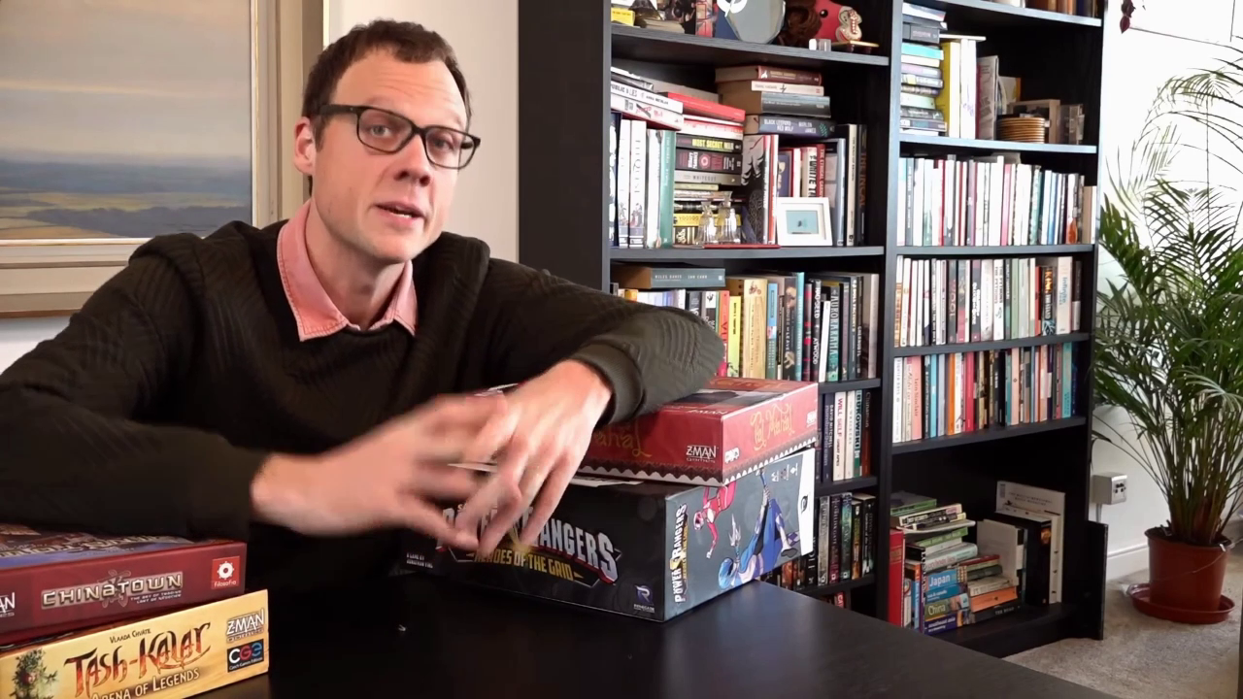
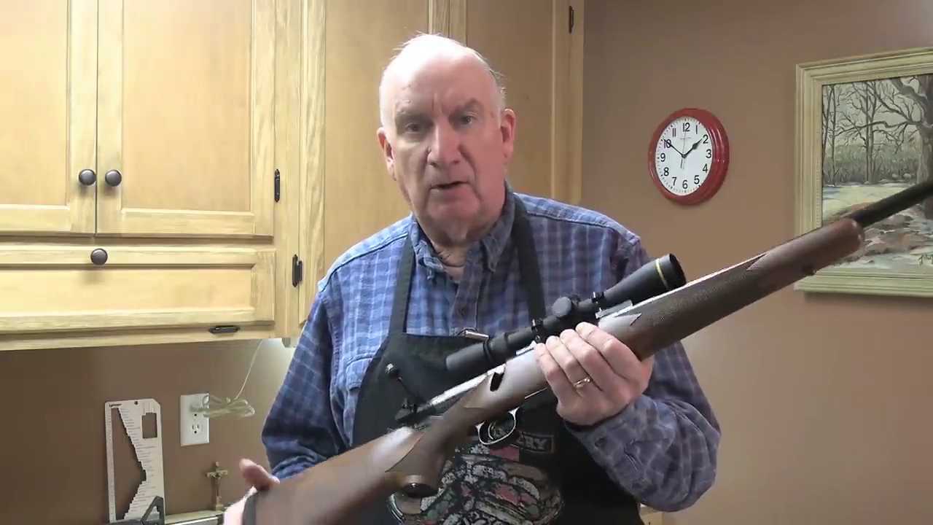
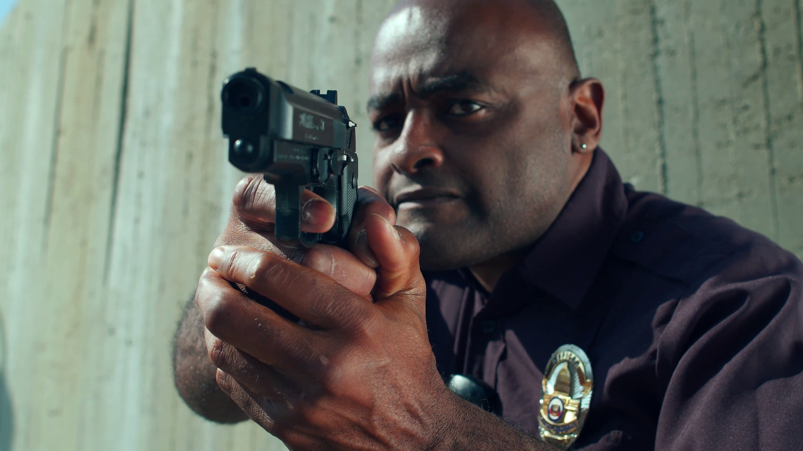
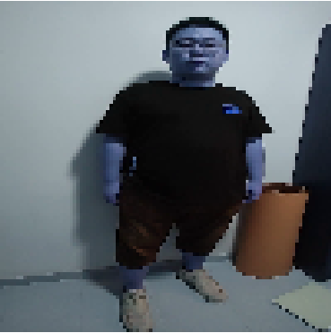
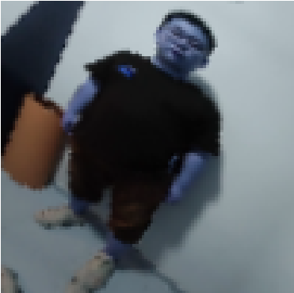
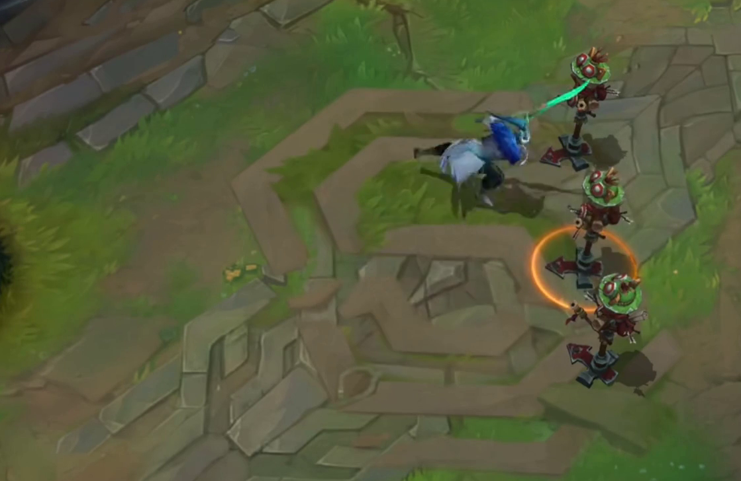
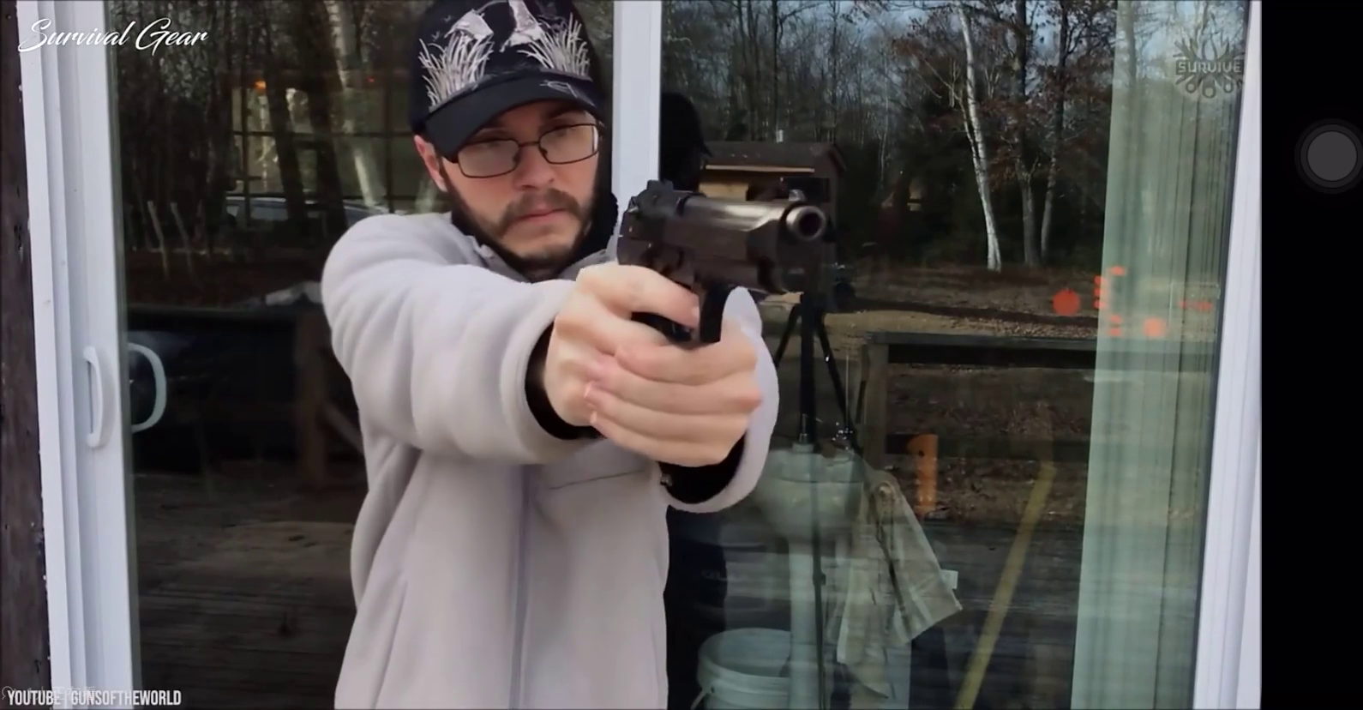
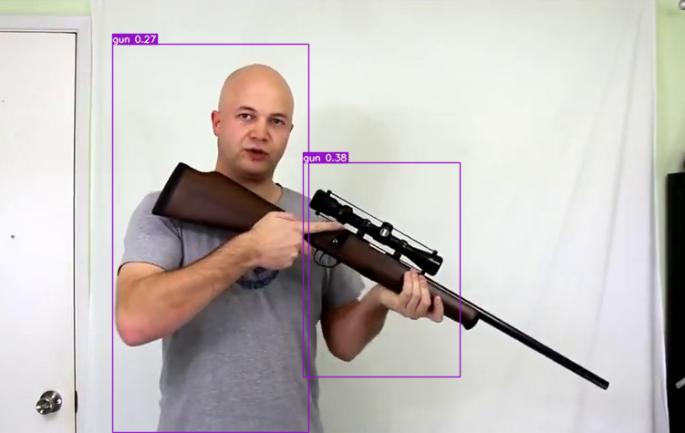
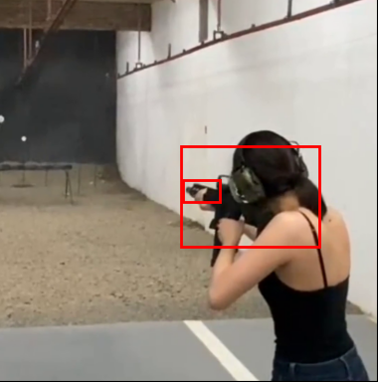
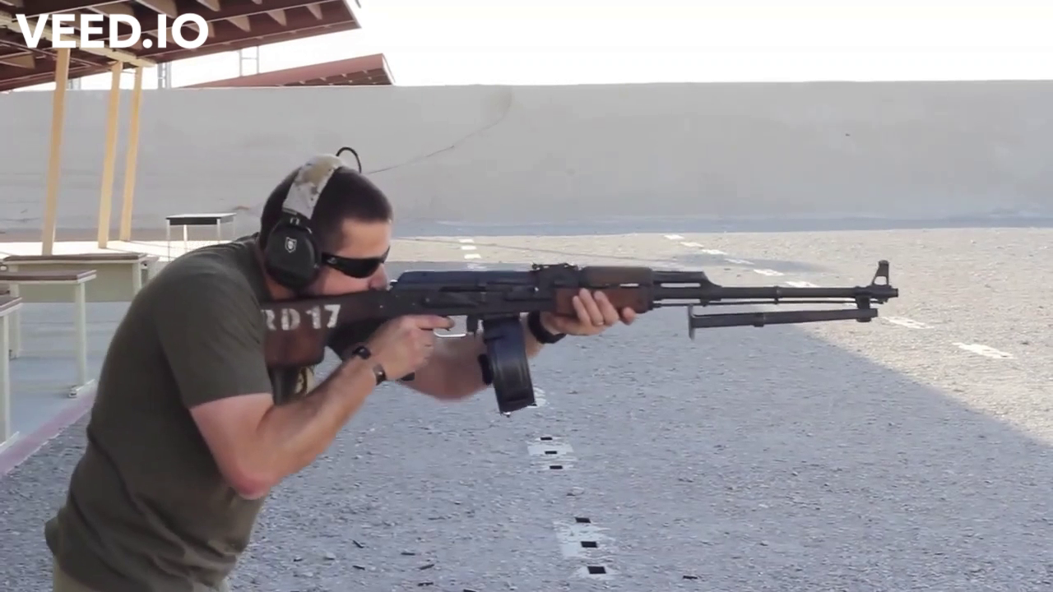
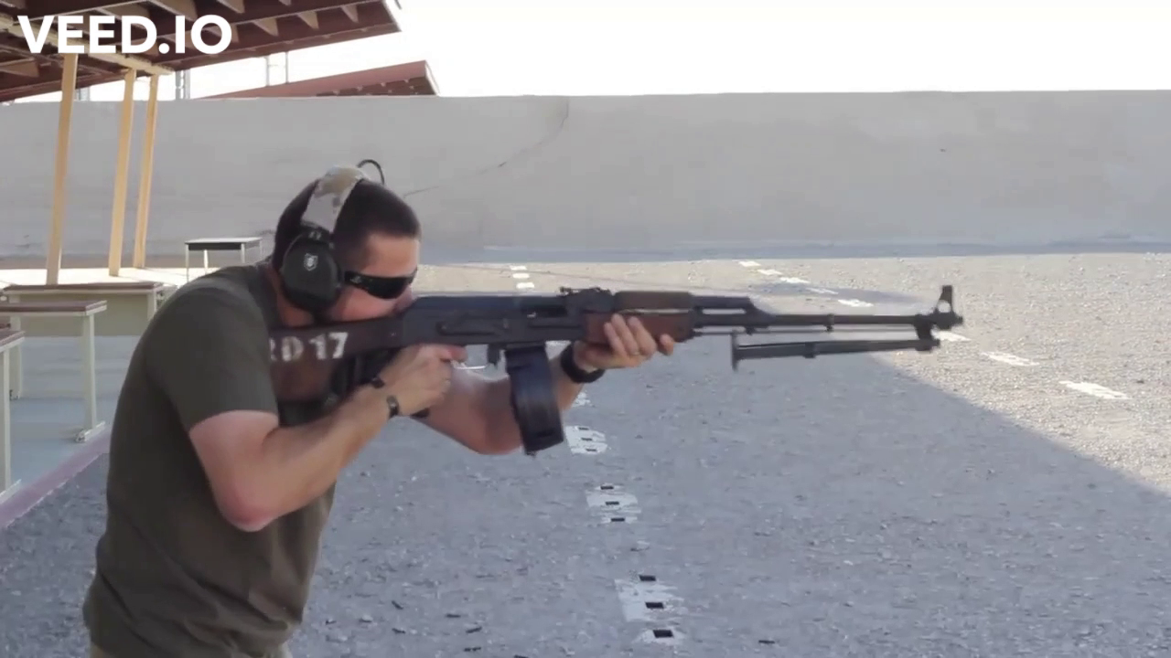
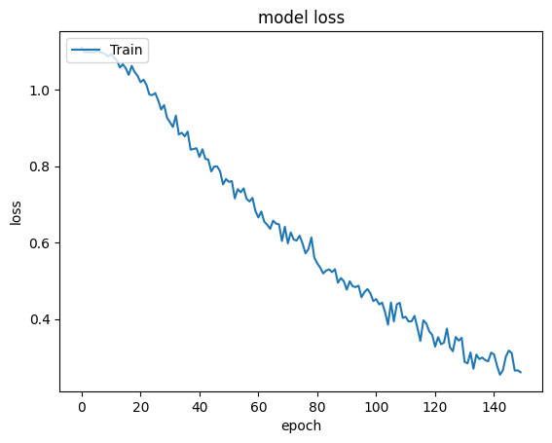
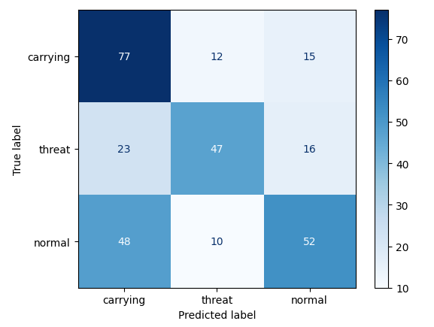
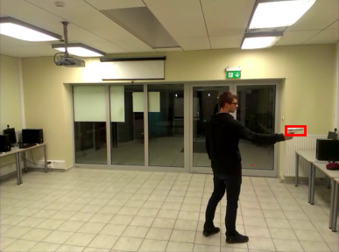
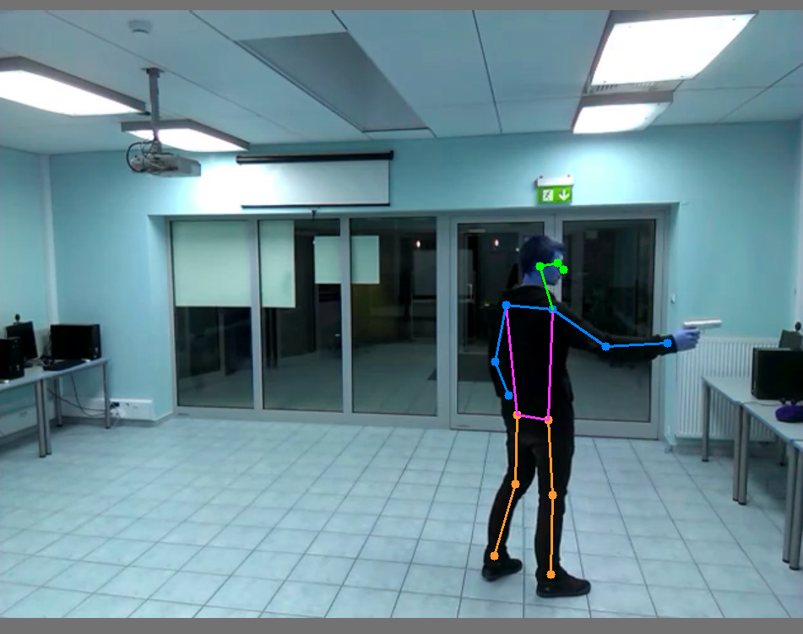
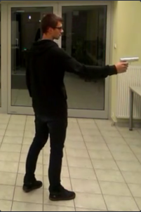
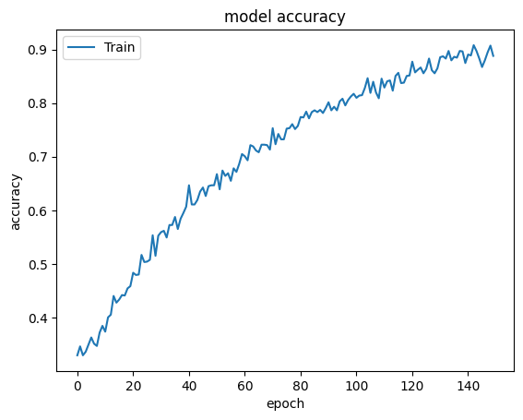
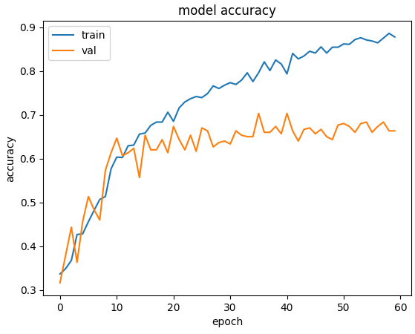
CS4243 - Computer Vision and Pattern Recognition - Mini Project
Threat Image Classifier
Group 30
S Dinesh Raj | Myat Htet Kyaw | Yong Ray Wen Joshua | Muhammad Hanif Bin Muhammad Kamal
Dataset (cs4243_smallest)
Combating Overfitting in CNN
Object Detection Techniques
Still images from Dataset; No videos were processed.
No of Classes: 3
Data Augmentation
Introduce image transformations as a preprocessing layer in model
Transformations include:
Random zoom, horizontal and vertical flip, rotation
Effectively increase size of training dataset
Training Accuracy: 76%
Validation Accuracy: 59%
Add dropout after each layer
Add dropout in all layers incremental in levels of 20% to 40%.
Training accuracy: 96%
Validation Accuracy: 65%
Conclusion:
Despite increasing model accuracy and minimising overfit interval, we were able to reduce overfit but not eliminate it.
Pose Detection with YOLOv7
Processed dataset using YOLOv7 with pretrained model weights and used this
new dataset with poses highlighted as
training dataset for our improved CNN but no significant improvement in validation accuracy observed.
Class: Normal
Sample: 1857
Class: Carrying
Sample: 1535
Class: Threat
Sample: 1551
Data Preprocessing
Manual relabelling and removal of pollution
Object Detection with YOLOv7
Trained model on dataset of >8000 images with YOLOv7 labels
Poor performance, likely due to insufficient epochs.
“Threat” → removed
“Carrying” → Threat
Class | Normal | Carrying | Threat
Count | 1567 | 1021 | 540
Object Detection with Region-based CNN (RCNN)
2. Manual undersampling to remove imbalance
Preferentially remove similar images
Using model with pre-trained weights on a dataset of
only 333 images of pistols and rifles. Good performance in detection without labelling.
Class | Normal | Carrying | Threat
Count | 500 | 500 | 500
F1 Score: 0.585474275880426
Precision: 0.6093119048855037
Recall: 0.5865411720062883
(Macro Averages)
Using Object Detection to Crop Images
Baseline CNN
Using saved points from both pose detection and weapon detection to determine a new boundary to extract out the most important features and ignoring the surrounding environment.
Baseline CNN implementation
Resize each image to 100x100 pixels
Converted the images to grayscale
Randomised selection from unfiltered dataset
5 convolutional layers, 2 dense layers
Epochs = 10
Actionativation function = relu(for all layers), softmax (final)
Optimiser = Adam
Training Accuracy: 66%
Validation Accuracy: 38%
CNN implementation with cleaned dataset
Hyperparameter tuning
Changed learning rate
Higher epochs
Training Accuracy: 86%
Validation Accuracy: 45%
Observed: Overfitting
Training CNN with previous enhancements on new dataset, accuracy is slightly increased.
Training Accuracy: 88%
Validation Accuracy: 68%
TRANSFER LEARNING - ResNet18
Pre-Trained Neural Network.
18 layers with more than 1,000,000 images.
Changed the final layer to 3 (to represent classes).
Training Accuracy: 94%
Validation Accuracy: 75%
In efforts to reduce overfit, added dropout of 0.2 to the final layer.
Training Accuracy: 80%
Validation Accuracy: 78%
MEMBER CONTRIBUTION
S Dinesh Raj
Data preprocessing, Baseline CNN + fine tuning (Dropout), Resnet
Myat Htet Kyaw
Data preprocessing, Pose detection, Object detection
Yong Ray Wen Joshua
Data preprocessing, Object detection, Further preprocessing with object detection
Muhammad Hanif Bin Muhammad Kamal
Data preprocessing, Data augmentation implementation in CNN

